Slide 1
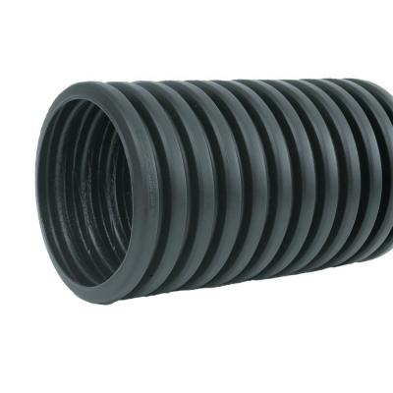
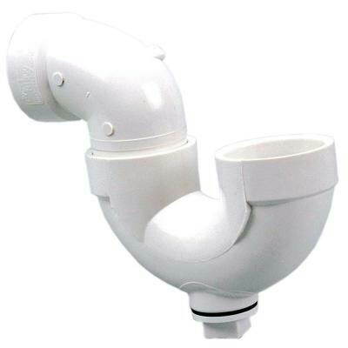
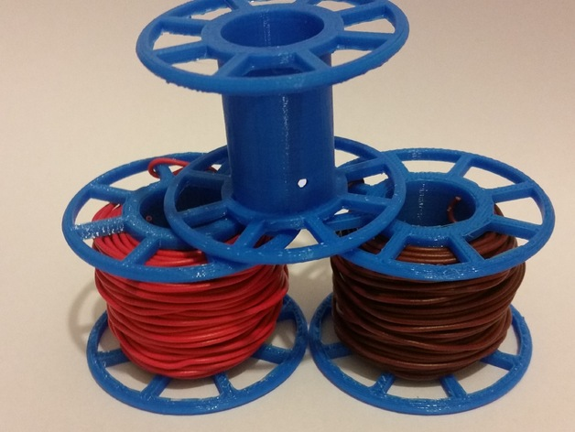
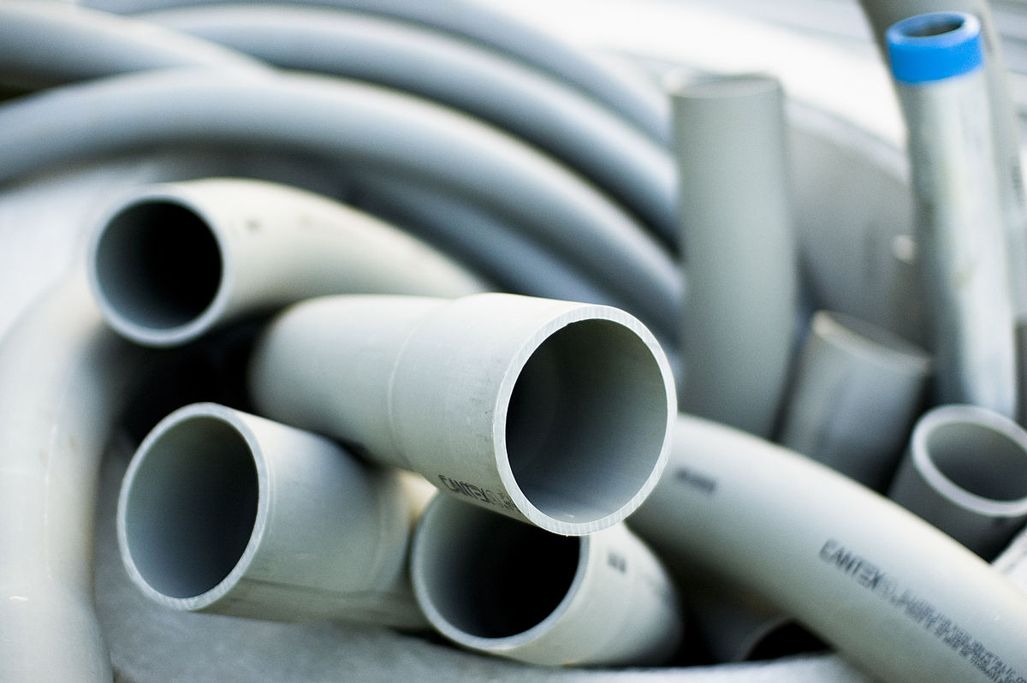
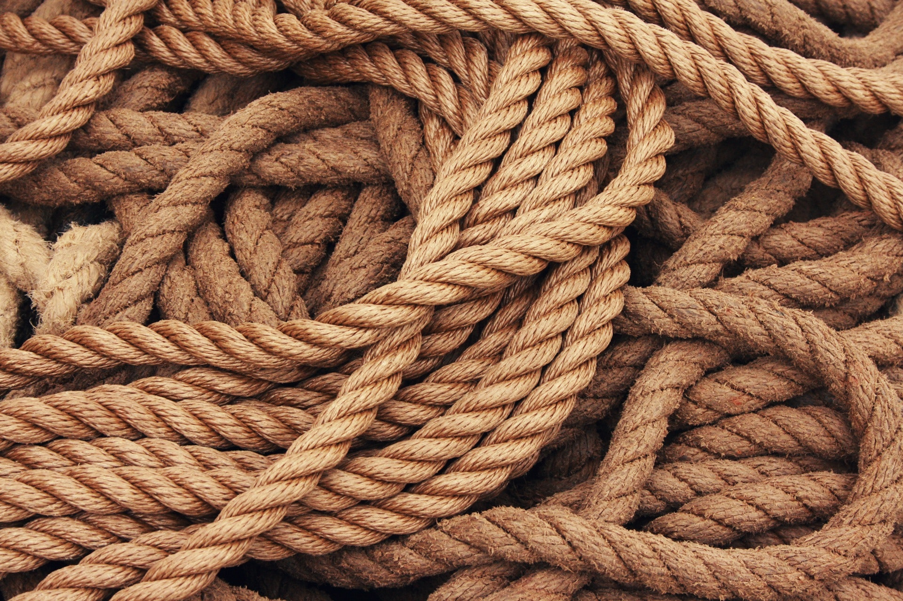
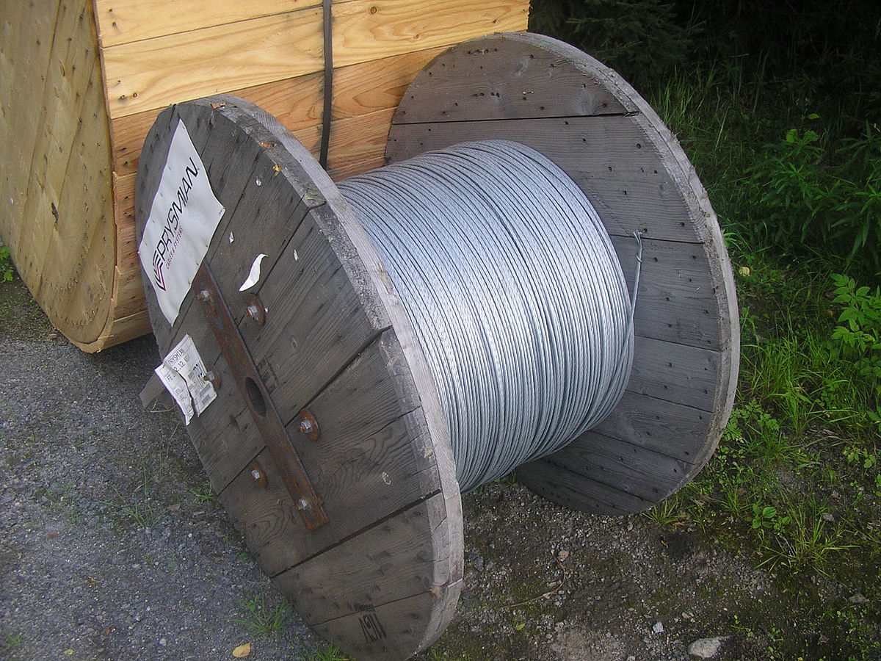
Hardware Store Waste – Our Treasures!
What are Loose Parts?
Loose parts are open ended materials that can be assembled, combined and manipulated in a variety of ways and have no predetermined play pattern.
The value of Loose Parts is that they can redesigned and repurposed as the individual sees fit.
They may be used alone, or in addition to other materials.
They can be synthetic or natural materials and many treasures can be recycled items.
Loose Parts in play help kids to:
Problem solve and use theoretical reasoning
Think creatively
Find excitement and adventure through play
Practice social skills and team work, including communication
Be physical active and move more
Engage in a wide range of play
Achieve school curriculum objectives through play
Find endless opportunities for imaginative play and creation
Key to using waste for loose parts: items must be absent of sharp edges and should be mostly whole.
Examples of Great Loose Parts

