Slide 1
Using Loose Parts for Learning
Loose Parts are a great tool for learning through play, curiosity and exploration.
What are Loose Parts?
Loose parts are open ended materials that can be assembled, combined and manipulated in a variety of ways and have no predetermined pattern for use.
The value of loose parts is that they can redesigned and repurposed as the individual sees fit.
They may be used alone, or in addition to other materials.
They can be synthetic or natural materials and many treasures can be recycled items
Benefits of Loose Parts
Problem solving and theoretical reasoning
Ability to think creatively
Excitement and adventure through play
Social skills and team work, including communication and negotiation skills
Physical activity & movement
Endless opportunities for imaginative play and creation
Loose Parts Should Be…
Open ended to allow kids to experiment
Made available and easily accessible for so they can use them independently
Checked for safety (sharp edges, nails), well maintained and set out in rotation

Slide 2
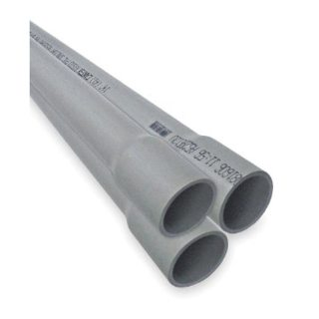
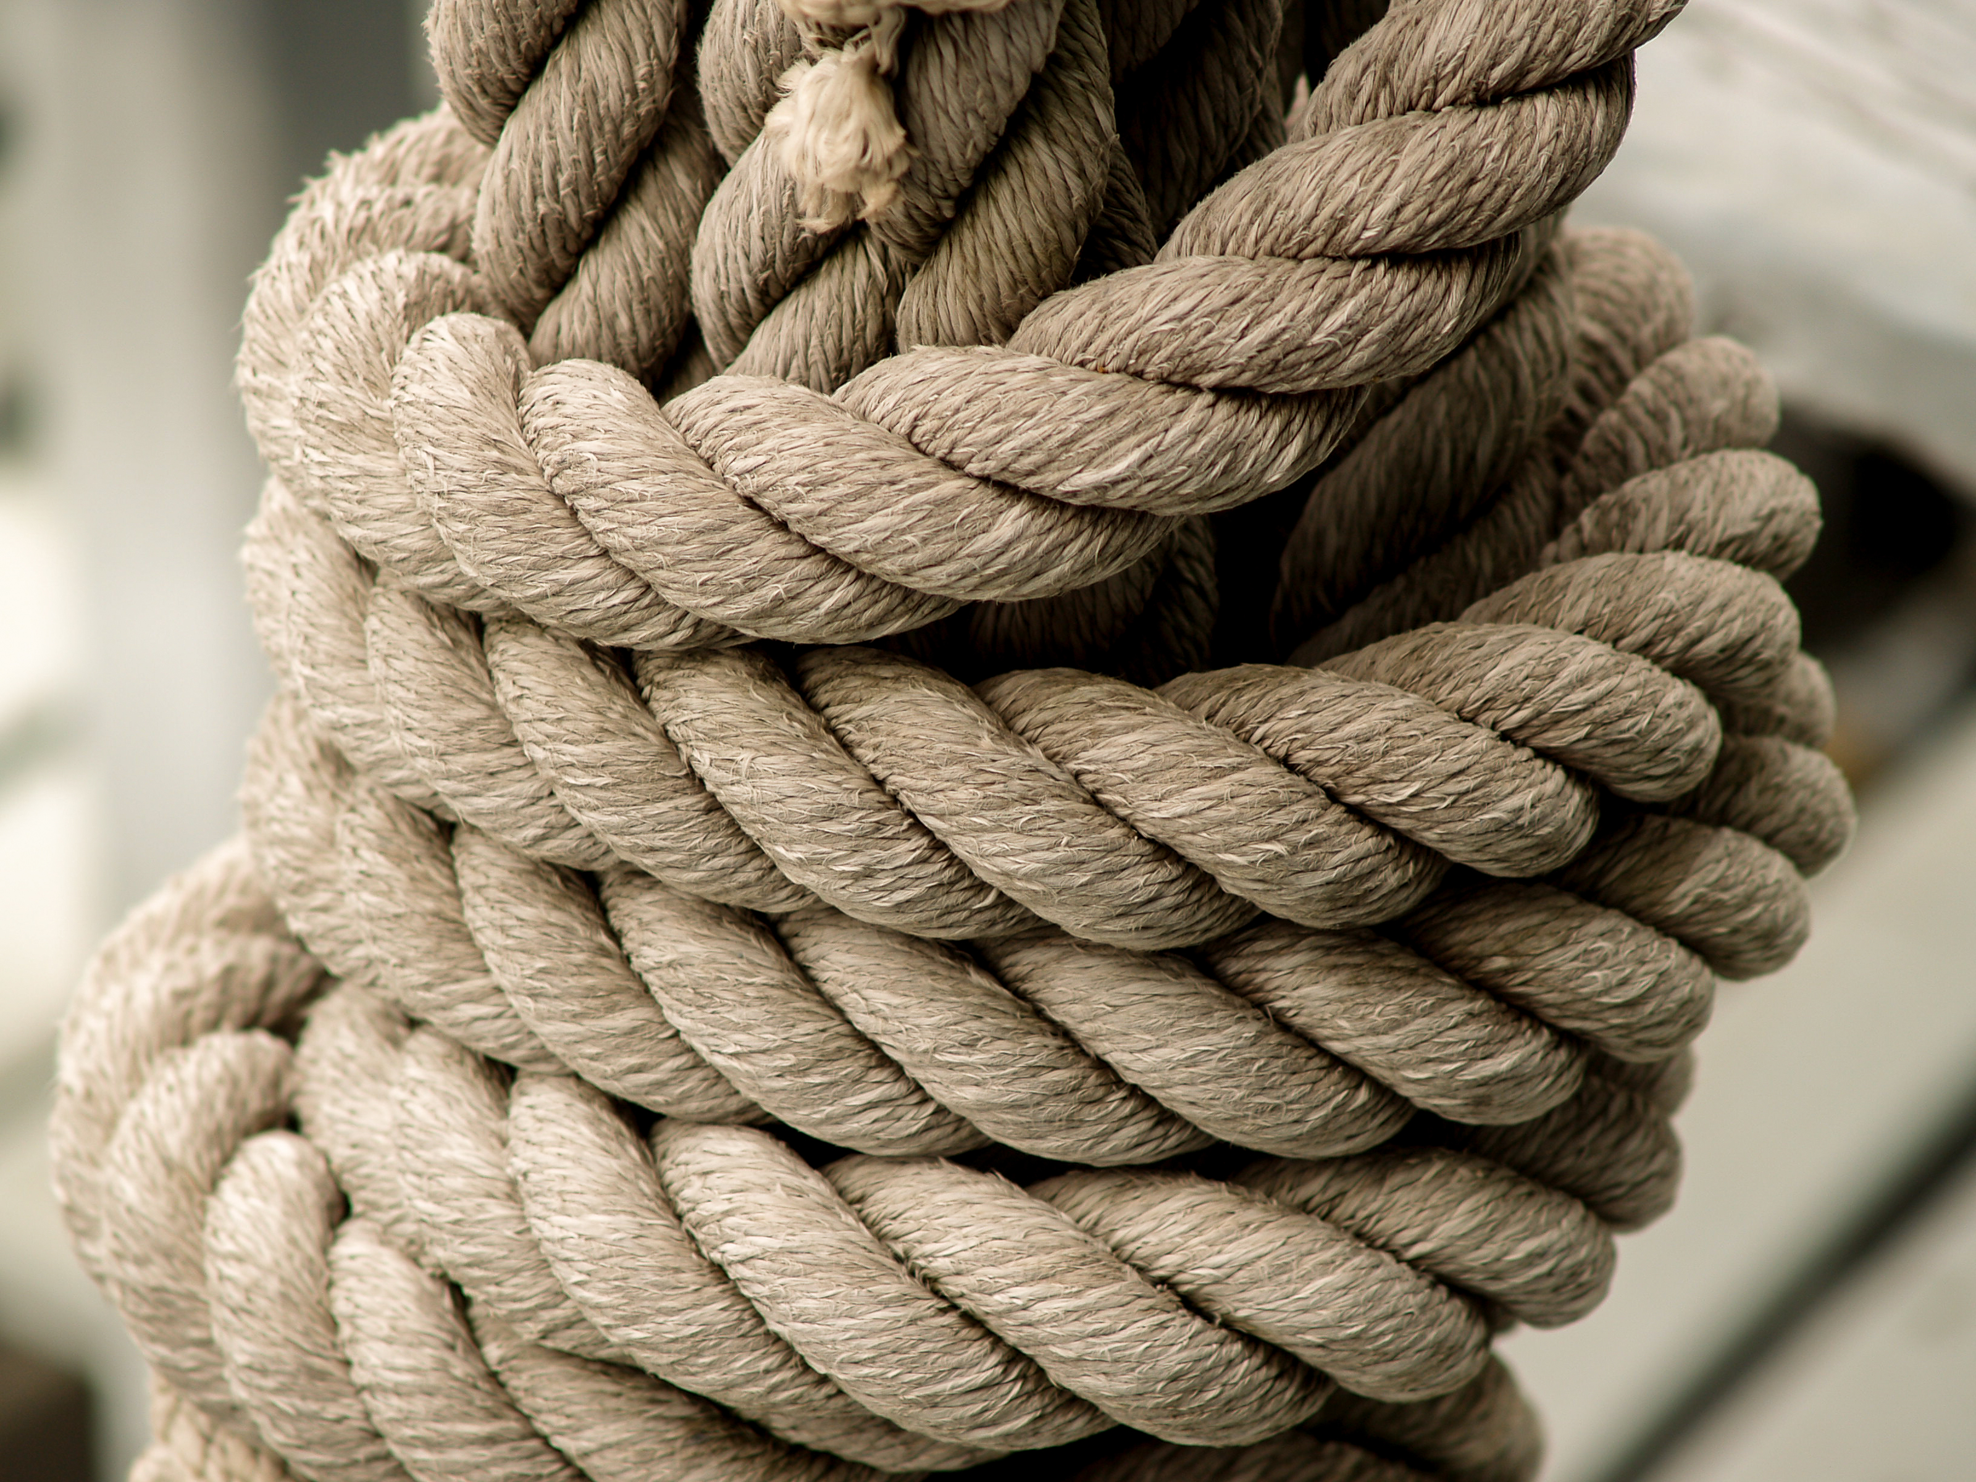

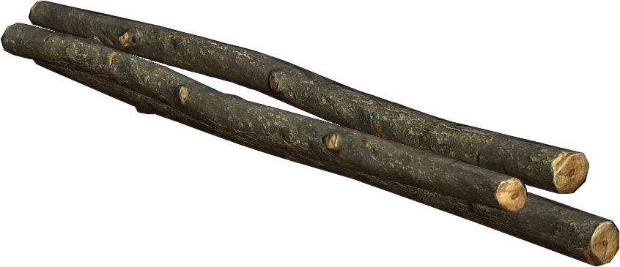
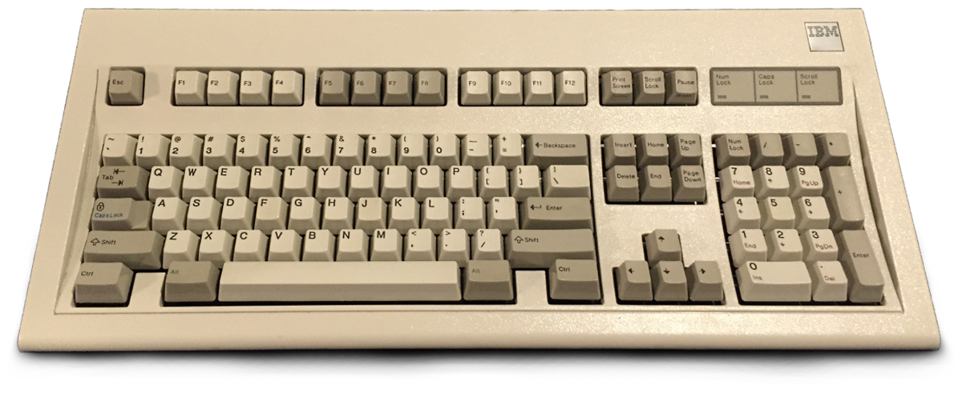
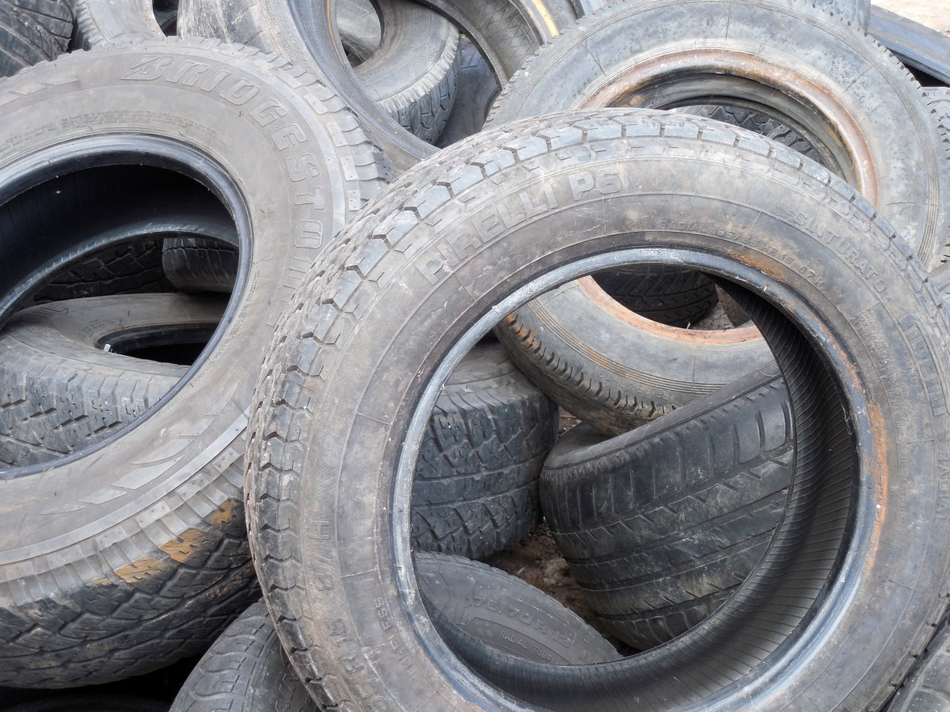
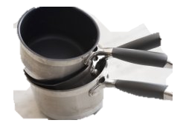
Natural
Found
Diverted Waste
Manufactured

